Slide 1
OpenGL and GLUT Basics

Slide 2
Outline
OpenGL & GLUT basics
  Grpahics Pipeline
  2-D drawing
  User interaction

Slide 3
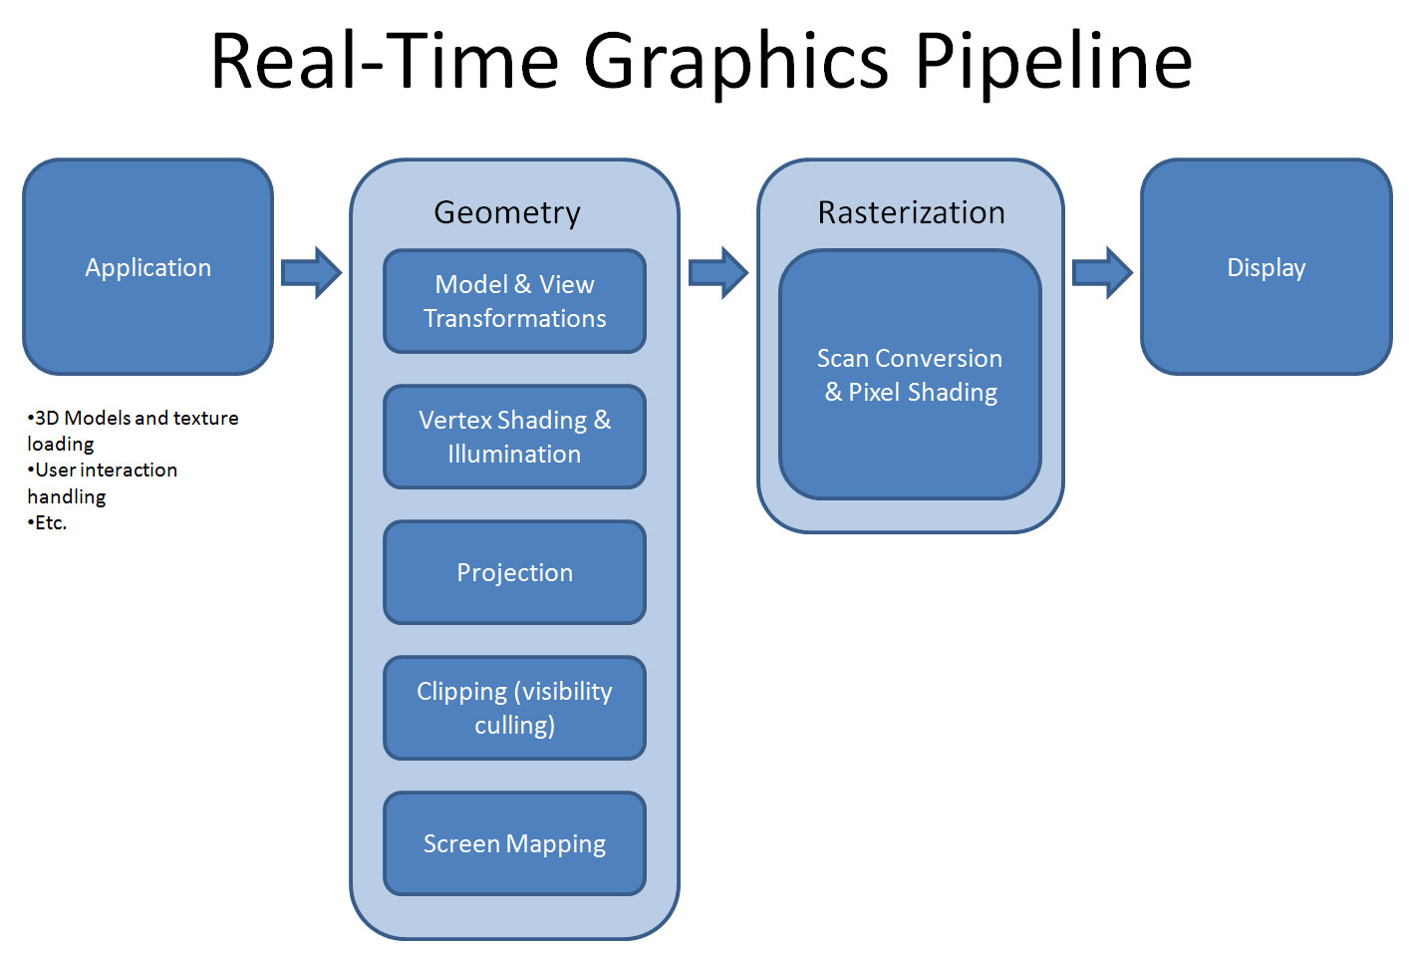
Graphics Pipeline

Slide 4
OpenGL – What is It?
GL (Graphics Library): Library of 2-D, 3-D drawing primitives and operations
  API for 3-D hardware acceleration
GLU (GL Utilities): Miscellaneous functions dealing with camera set-up and higher-level shape descriptions
GLUT (GL Utility Toolkit): Window-system independent toolkit with numerous utility functions, mostly dealing with user interface

Slide 5
Event-driven GLUT program structure
1. Configure and open window
2. Initialize OpenGL state, program variables
3. Register callback functions
• Display (where rendering occurs)
• Resize
• User input: keyboard, mouse clicks, motion, etc.
4. Enter event processing loop

Slide 6
Call Back Function
A callback function is a function passed into another function as an argument, which is then invoked inside the outer function to complete some kind of routine or action.
In C, a callback function is a function that is called through a function pointer

Slide 7
Simple OpenGL program
#include <stdio.h>
#include <GL/glut.h>
void main(int argc, char** argv)
{
  glutInit(&argc, argv); // configure and open window
  glutInitDisplayMode(GLUT_RGB | GLUT_DOUBLE);
  glutInitWindowSize(100, 100);
  glutCreateWindow(“hello”);
  init(); // set OpenGL states, variables
  glutDisplayFunc(display); // register callback routines
  glutKeyboardFunc(keyboard);
  glutMainLoop(); // enter event-driven loop
}

Slide 8
Configure and open window
• glutInit: Pass command-line flags on to GLUT
• glutInitDisplayMode: OR together bit masks to set modes on pixel type
• glutInitWindowSize, glutCreateWindow: Set drawing window attributes, then make it

Slide 9
Initialize OpenGL state
• init(): Set OpenGL state, program variables
– Use GL types/typedefs GLfloat, GLint, GL_TRUE, GL_FALSE, etc. for
cross-platform compatibility
void init() {
  glClearColor(0.0, 0.0, 0.0, 0.0);
  glMatrixMode(GL_PROJECTION);
  glLoadIdentity();
  gluOrtho2D(0, right, 0, top);
}
sets “units” of subsequent draw commands

Slide 10
OpenGL screen coordinates
• Bottom left corner is origin
• gluOrtho2D() sets the units of the screen
coordinate system
•gluOrtho2D(0, w, 0, h) means the
coordinates are in units of pixels
•gluOrtho2D(0, 1, 0, 1) means the
coordinates are in units of “fractions of window
size” (regardless of actual window size)
glOrtho2D(L,R,B,T);

Slide 11
glutInitWindowSize sets the size of the window.
Use glViewport to specify the window region in window coordinates to be drawn to.
gluOrtho2D specifies the coordinates to be used with the viewport which defaults to the window size.

Slide 12
So, if you want create a 400 x 400 window and only want to draw to the rectangle(50, 50, 350, 350) within the window, then use glViewport(50, 50, 350, 350). You would then use gluOrtho2D to set your GL coordinates wthin the viewport. So, if you used gluOrtho2D(-1.0, 1.0, -1.0, 1.0) then visible GL coordinates would range from -1.0 to 1.0 in the x direction, from -1.0 to 1.0 in the y direction.

Slide 13
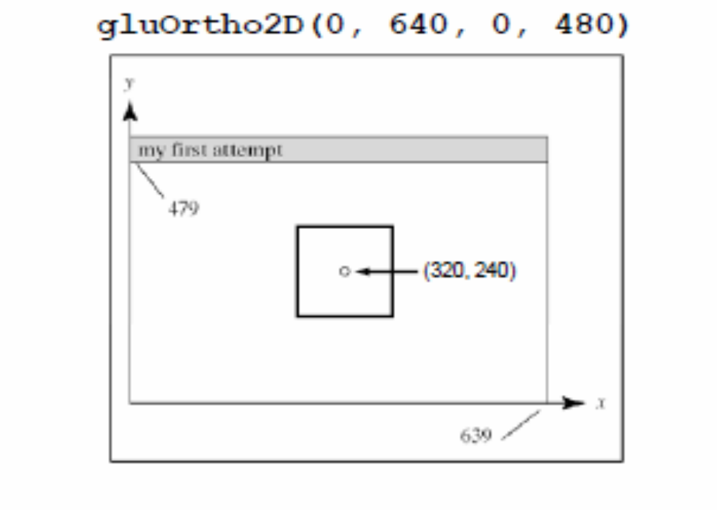
Example: Specifying the center of a square

Slide 14
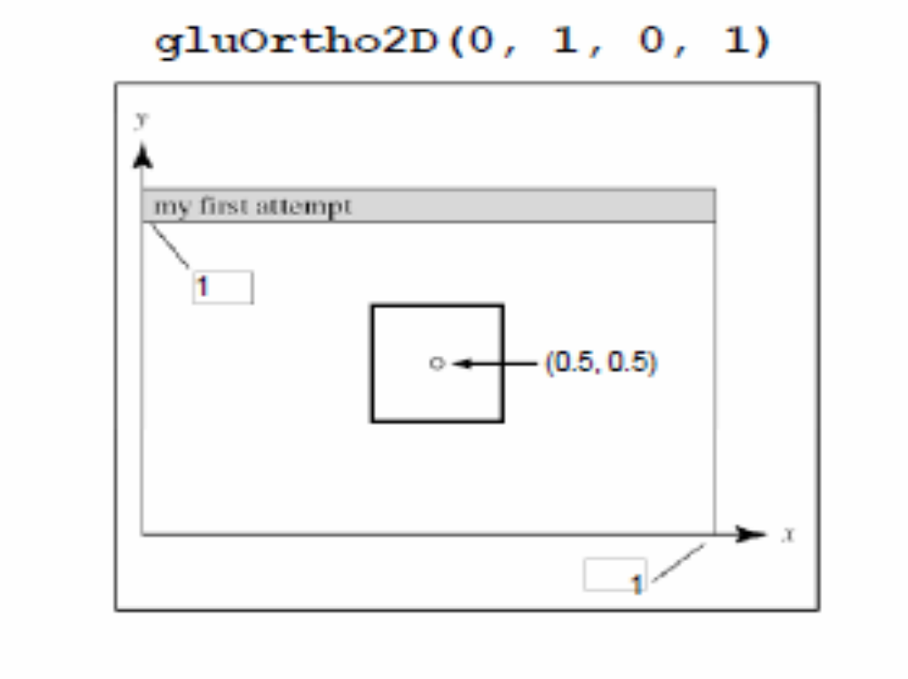
Example: Specifying the center of a square

Slide 15
A complete OpenGL program
#include <stdio.h>
#include <GL/glut.h>
void main(int argc, char** argv)
{
  glutInit(&argc, argv);
  glutInitDisplayMode (GLUT_SINGLE | GLUT_RGB);
  glutInitWindowSize (640, 480);
  glutInitWindowPosition (100, 150);
  glutCreateWindow ("my first attempt");
  glutDisplayFunc(myDisplay);
  myInit ();
  glutMainLoop();
}

Slide 16
A complete OpenGL program (cont.)
void myDisplay(void)
{
  glClear (GL_COLOR_BUFFER_BIT);
  glColor3f (0.0, 0.0, 0.0);
  glPointSize(4.0);
  glBegin(GL_POINTS);
  glVertex2i(100, 50);
  glVertex2i(100, 130);
  glVertex2i(150, 130);
  glEnd();
  glFlush ();
}

Slide 17
A complete OpenGL program (cont.)
void myInit (void)
{
  glClearColor(1.0, 1.0, 1.0, 0.0);
  glColor3f(0.0f, 0.0f, 0.0f);
  glPointSize(4.0);
  glMatrixMode(GL_PROJECTION);
  glLoadIdentity();
  gluOrtho2D(0.0, 640.0, 0.0, 480.0);
}

Slide 18
Rendering Steps
In function registered with glutDisplayFunc():
1. Clear window
• glClear(GL_COLOR_BUFFER_BIT);
2. Draw shapes
• Set colors, patterns, point/line sizes
• Specify type of geometric primitive(s) and list vertices
3. Swap buffers if display mode is GLUT_DOUBLE
4. Force all operations to complete with glFlush()

Slide 19
Single- vs. double-buffering
• Single-buffering: Draw directly to screen buffer
• Double-buffering: Draw to offscreen
buffer, then make that the screen buffer when done
• For animation, double-buffering is better because it eliminates flickering

Slide 20
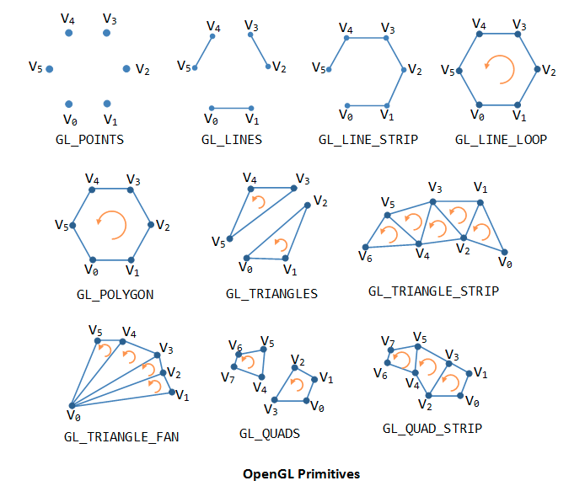
OpenGL Geometric Primitives

Slide 21
Windows Config: glut
Unzip glut-3.7.6-bin.zip and you will get
1. glut.h
2. glut32.dll
3. glut32.lib

Slide 22
Windows Config: glut
Visual Studio 2010
Windows (7/8)
====================
On 32bit versions of windows:
  copy glut.h in include/GL folder to C:\Program Files\Microsoft SDKs\Windows\v7.0A\Include\gl
  copy glut32.lib in lib folder to C:\Program Files\Microsoft SDKs\Windows\v7.0A\Lib
  copy glut32.dll to C:\windows\system32
On 64bit versions of windows:
  copy glut.h in include/GL folder to C:\Program Files(x86)\Microsoft SDKs\Windows\v7.0A\Include\gl
  copy glut32.lib in lib folder to C:\Program Files(x86)\Microsoft SDKs\Windows\v7.0A\Lib
  copy glut32.dll to C:\windows\SysWOW64

Slide 23
Windows Config: glut
Visual Studio 2012
Windows (7/8)
====================
On 32bit versions of windows:
  copy glut.h in include/GL folder to C:\Program Files\Microsoft Visual Studio 11.0\VC\include\gl
  copy glut32.lib in lib folder to C:\Program Files\Microsoft Visual Studio 11.0\VC\lib
  copy glut32.dll to C:\windows\system32
On 64bit versions of windows:
  copy glut.h in include/GL folder to C:\Program Files (x86)\Microsoft Visual Studio 11.0\VC\include\gl
  copy glut32.lib in lib folder to C:\Program Files (x86)\Microsoft Visual Studio 11.0\VC\lib\amd64
  copy glut32.lib in lib folder to C:\Program Files (x86)\Microsoft Visual Studio 11.0\VC\lib
  copy glut32.dll to C:\windows\SysWOW64

Slide 24
Windows Config: glut
CodeBlocks 16.01MinGw [https://sourceforge.net/projects/codeblocks/files/Binaries/16.01/Windows/codeblocks-16.01mingw-setup.exe/download]
Windows (7/8/10)
====================
On 32bit versions of windows:
  copy glut.h in include/GL folder to C:\Program Files(x86)\CodeBlocks\MinGW\include\GL
  copy glut32.lib in lib folder to C:\Program Files (x86)\CodeBlocks\MinGW\lib
  copy glut32.dll to C:\windows\system32
New Project-> Glut Project
Select Glut Location
  C:\Program Files (x86)\CodeBlocks\MinGW

Slide 25
Windows Config: glut
New Project-> Glut Project
Select Glut Location
  C:\Program Files (x86)\CodeBlocks\MinGW

